Slide 1


Unit testing in Java
INTRODUCTION
Jupiter API

Slide 2
Unit testing
UNIT TESTING is a level of software testing where individual units/ components of a software are tested.
The purpose is to validate that each unit of the software performs as designed.
A unit is the smallest testable part of any software. It usually has one or a few inputs and usually a single output.
https://junit.org/junit5/

Slide 3
Mocking
Mocking is a process used in unit testing when the unit being tested has external dependencies.
The purpose is to isolate and focus on the code being tested and not on the behavior or state of external dependencies.
Replacements for external dependencies
Fake
Stubs
Mocks
https://site.mockito.org/

Slide 4
Code coverage
Code coverage is a measure which describes the degree of which the source code of the program has been tested.
https://www.eclemma.org/jacoco/
sonarqube
Code quality
Duplicate code
Coding standard
Code coverage report
Security vulnerability
Etc..

Slide 5
Mutation testing
Mutation Testing is a type of software testing where we mutate (change) certain statements in the source code and check if the test cases are able to find the errors. It is a type of White Box Testing which is mainly used for Unit Testing.
https://pitest.org/

Slide 6
Integration testing
Spring boot testing
https://docs.spring.io/spring-framework/docs/5.0.0.BUILD-SNAPSHOT/spring-framework-reference/html/integration-testing.html

Slide 7
Tools
Unit testing – Junit 5
Mocking – Mockito
Code coverage – Jacoco
Code coverage reporter – SonarQube
Static code analysis – SonarQube
Integration testing – Spring boot testing library, cloud contract
Mutation testing- Pi

Slide 8
Junit4.x vs junit5.x
Architecture level difference
Annotation name difference
What’s new
  Java 8 lambda
  Different style of testing

Slide 9
Junit4.x vs junit5.x
Architecture level difference
Minimum JDK version for Junit4 -> Jdk5 but for Junit5 -> Jdk8
Earlier it was single .jar
Now it’s 3 different .jar
JUnit Jupiter
  New programming model + extension to write test and extension
  It’s subproject provides test engine to run the Jupiter based tests
JUnit Vintage
  To run tests that are written in junit4 and junit3
JUnit platform
  Launch testing frameworks
  Define test engines
  Console launcher
  Junit4 based runner
  Integration with 3rd party

Slide 10
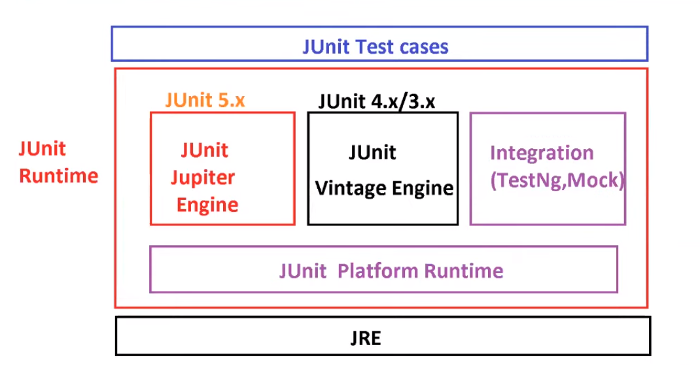

Slide 11
Junit4.x vs junit5.x
Annotation names difference
Junit4 | Junit5
@Before | @BeforEach
@After | @AfterEach
@BeforClass | @BeforAll
@AfterClass | @AfterAll
@Ignore | @Disabled
@Category | @Nested

Slide 12
New features/annotations in junit5.x
@TestFactory
@Nested
@ExtendWith
New way to test exceptions
@SelectPackages and @SelectClasses

Slide 13
Test Class
Any class that contains at least on test method
Test classes must not be abstract and
must have a single constructor.

Slide 14
Few points to note
test methods and lifecycle methods must not be abstract and must not return a value.
Test classes, test methods, and lifecycle methods are not required to be public, but they must not be private.

Slide 15
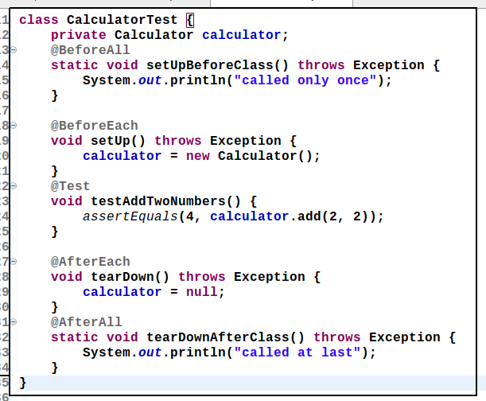
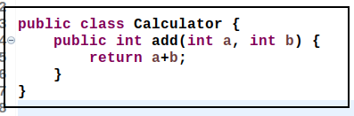
Examples test cases

Slide 16
Some Important Annotations
@Test
@DisplayName
@BeforeEach
@AfterEach
@BeforeAl
@AfterAll
@Disable
@TestMethodOrder
@RepeatTest
@Tag
@ParameterizedTest
@ParameterizedTest,
@TestFactory, or
@TestTemplate.

Slide 17
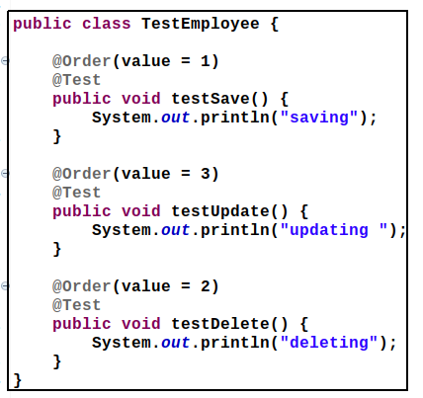
Order annotation

Slide 18
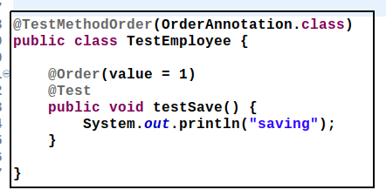
@TestMethodOrder
@TestMethodOrder : We can define multiple test methods inside Testcase.
Those are executed in Random order by default.
We can specify our own order using @TestMethodOrder + OrderAnnotation
Here we need to provide @Order(number).
We can use @TestMethodOrder(Alphanumeric.class) for provide test method order.
First sort using 0-9 if same found then compare with A-Z sorting order.

Slide 19
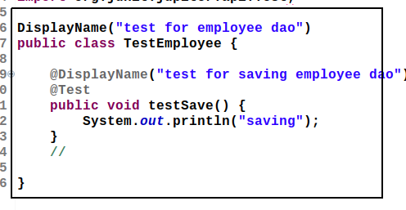
@DisplayName
This annotation is used to provide 'Readable text' inplace of
actual method and class names at JUnit console.

Slide 20
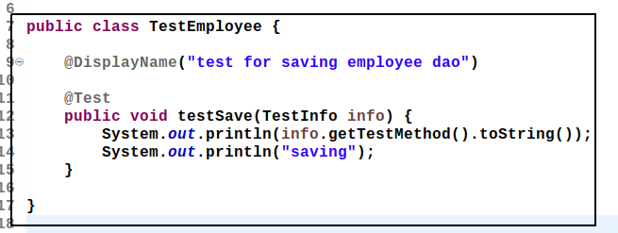
Injecting TestInfo to get valuable informations
To know our Test case details like classname,method name, display name,tag name etc
we can use one interface TestInfo

Slide 21
@DisplayName
This annotation is used to provide 'Readable text' inplace of
actual method and class names at JUnit console.

Slide 22
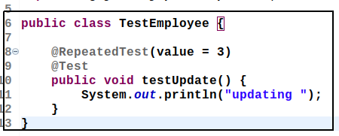
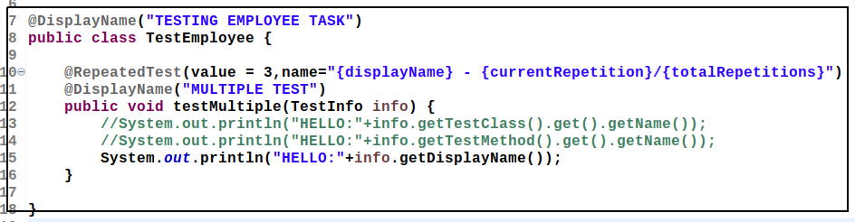
@RepeatedTest
@RepeatedTest
To execute any test method multiple time (like batch processing) using
@RepeatedTest annotation.

Slide 23
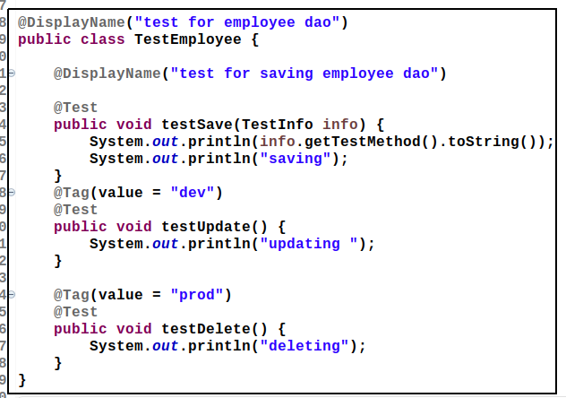
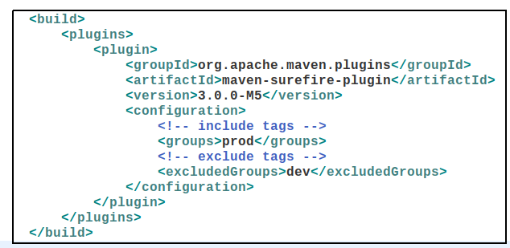
@Tag
These are used to filter test methods for execution in different environments.
For Example, i want to test export example in production env at same
i want to test delete operation only in development environment
then use tag concept and maven-surefire-plugin in pom.xml

Slide 24

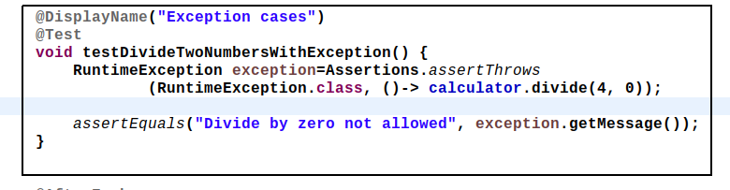
Exception test cases

Slide 25
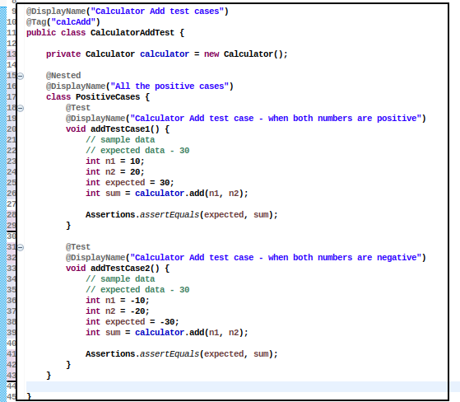
Nested test

Slide 26
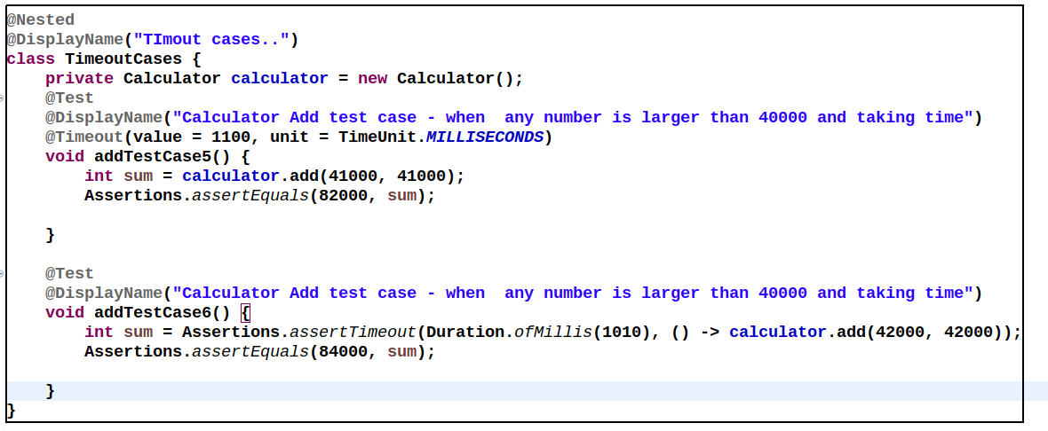
Timeout testing

Slide 27
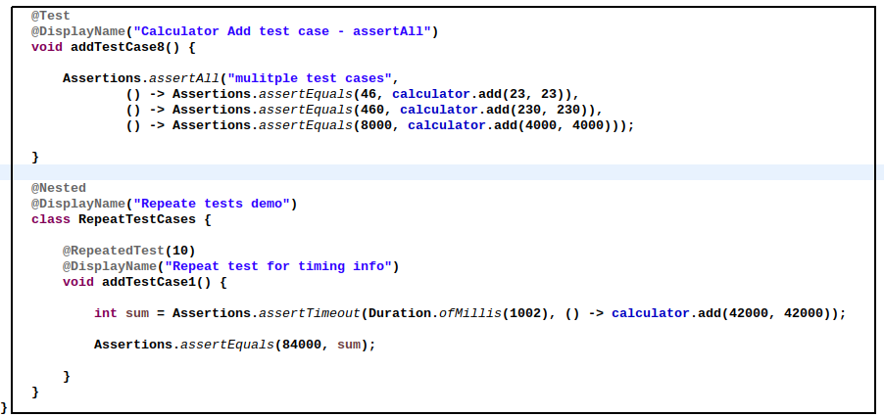
Assertions, AssertAll,@Nested, @RepeatTest

Slide 28
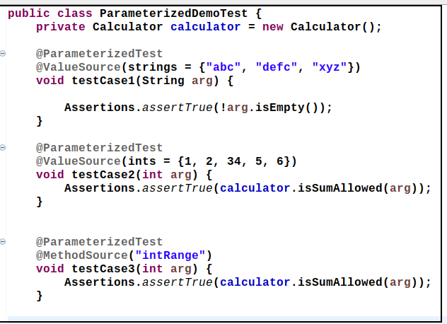
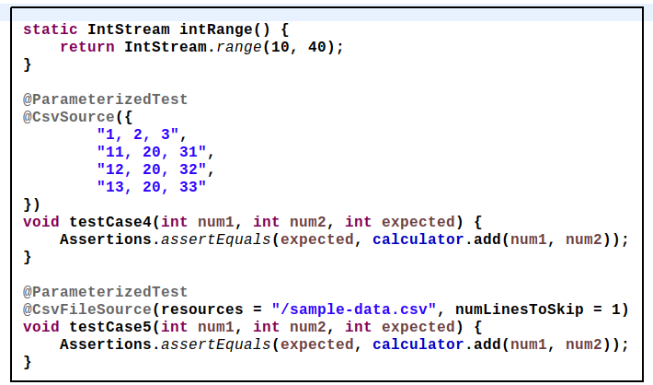
@Parameterized

Slide 29
Few points..
Execution order
  Default – Fixed, non-deterministic
  Random
  Alphanumeric
  Order annotation
Test Instance
  Per method – default
  Per class

Slide 30

Introduction
What/Why

Slide 31
Why mocking is needed??
A unit test should test functionality in isolation. Side effects from other classes or the system should be eliminated for a unit test, if possible.

Slide 32
Test doubles
Test replacement of real/external dependencies
  Dummy Object
    Passed around but never used
  Fake objects
    Like memory db for actual db
  A stub class
    Initialize > exercises > verify
    To test data
  Mock object
    Initialize > set expectations > exercise > verify
    To test behavior

Slide 33
Mockito is a mocking framework for Java. Mockito allows convenient creation of substitutes of real objects for testing purposes.
Mock dependencies
execute code in the class
verify

Slide 34
Let’s see some code examples

Slide 35
Limitations of Mockito library
Can’t mock
  Static methods
  Private methods
Can’t mock constructors
Detailed –
  https://github.com/mockito/mockito/wiki/FAQ#what-are-the-limitations-of-mockito

Slide 36

Code coverage

Slide 37
What is code coverage??
Code coverage is a measurement of how many lines/blocks of your code are executed while the automated tests are running.

Slide 38
How it’s measured??
Code coverage is collected by using a specialized tool to instrument the binaries to add tracing calls and run a full set of automated tests against the instrumented product.
Steps
  Source/Intermediate code instrumentation
  Runtime information collection

Slide 39
Code coverage criteria
Function Coverage –
  The functions in the source code that are called and executed at least once.
Statement Coverage –
  The number of statements that have been successfully validated in the source code.
Path Coverage –
  The flows containing a sequence of controls and conditions that have worked well at least once.
Branch or Decision Coverage –
  The decision control structures (loops, for example) that have executed fine.
Condition Coverage –
  The Boolean expressions that are validated and that executes both TRUE and FALSE as per the test runs.

Slide 40
Integration with spring boot and Gradle

Slide 41
Why do we measure code coverage??
Following reasons:
  To know how well our tests actually test our code
  To know whether we have enough testing in place
  To maintain the test quality over the lifecycle of a project
While code coverage is a good metric of how much testing you are doing, it is not necessarily a good metric of how well you are testing your product.

Slide 42


Slide 43
Sonarqube
An open-source platform developed by SonarSource for continuous inspection of code quality
Perform automatic reviews
Static analysis of code to detect bugs, code smells, and security vulnerabilities on 20+ programming languages.
SonarQube offers reports on duplicated code, coding standards, unit tests, code coverage, code complexity, comments, bugs, and security vulnerabilities.

Slide 44
MUTATION TESTING
TESTING THE UNIT TESTS

Slide 45
What is Mutation testing
Faults (or mutations) are automatically seeded into your code, then your tests are run. If your tests fail then the mutation is killed, if your tests pass then the mutation lived.
The quality of your tests can be gauged from the percentage of mutations killed.

Slide 46
Why??
Traditional test coverage (i.e line, statement, branch, etc.) measures only which code is executed by your tests.
It does not check that your tests are actually able to detect faults in the executed code. It is therefore only able to identify code that is definitely not tested.
The most extreme examples of the problem are tests with no assertions. Fortunately these are uncommon in most code bases.
As it is actually able to detect whether each statement is meaningfully tested, mutation testing is the gold standard against which all other types of coverage are measured.

Slide 47
GOAL
identify weakly tested pieces of code (those for which mutants are not killed)
identify weak tests (those that never kill mutants)
compute the mutation score
learn about error propagation and state infection in the program

Slide 48
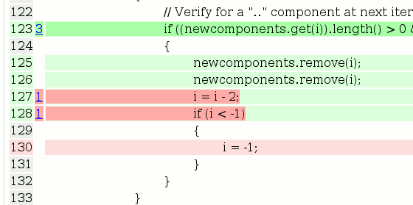
PIT – Java lib for mutation testing
PIT is
  Fast - can analyse in minutes what would take earlier systems days
  Easy to use - works with ant, maven, gradle and others
  Actively developed
  Actively supported
The reports produced by PIT are in an easy to read format combining line coverage and mutation coverage information.

